Slide 1
Collaborative Scoring Overview
Primarily designed for Windows 10 – not sure about MAC version.
Will only work if everything is correctly set up and steps taken in right sequence.
The bottom right-hand blue task bar will show the current synchronisation status
Both Scorers need to have the correct settings in their Tools menu.
Relies on both Scorers having a good Internet connection to PlayCricket throughout the match.
The Home Scorer must complete the match set up before the Away Scorer starts.
It will automatically check that the scorers agree at the end of every over.
Scorers have to be able to communicate directly with each other to be able to resolve any errors immediately

Slide 2
Collaborative Scoring – Before the Match
Will only work if everything is correctly set up and steps taken in right sequence.
Both Scorers need to have the correct setting(s) in their Tools menu.
  Configuration - Network – Tick all three boxes under Collaborative Scoring section
  It should only be necessary to tick once on any computer, but always worth checking
As a precaution, both Scorers should download fixture before arriving at the ground but then save and CLOSE.
  This will populate your database and can be used if a connection cannot be established as well as reducing later download time.
This may be an opportunity to check that the teams have been correctly uploaded by administrator.
If the match is covered by anti-corruption regulations, the option “Start with no Players” can be used.
If the teams have not been uploaded, then the missing team(s) will be auto populated with the players from the last match played by that team (either on Play-Cricket or in your own database)
If any additional players or officials are required, then look for them in the PlayCricket database.
Only as a last resort, should a new player can be created.

Slide 3
Collaborative Scoring – Start up
Will only work if everything is correctly set up and steps taken in right sequence.
Both Scorers have to be logged onto PlayCricket throughout the day.
The Away scorer must not access the match until after the Home scorer has completed the setup.
The Home Scorer should Start Match from Fixture in the usual way (in case teams have been changed).
The Away Scorer should assist the Home Scorer with any further Team changes (previous slide).
The Home Scorer should complete the setup of all the information for the match.
CHECK Scoring Sync Status (right end of task bar) is “Up to Date”
Only AFTER the match is setup completely can the Away Scorer download this information
  Open the Match
  Select the match
  REMEMBER to tick Download Latest from Server (right hand near bottom)
  OPEN as SUPPORT SCORER.
This will ensure that you are both scoring the same match with the same setup data (not scoring two different versions of the same match)

Slide 4
Collaborative Scoring – Play!
Relies on both Scorers having a good Internet connection to PlayCricket throughout the match
Both Scorers have to be logged onto PlayCricket throughout the match.
CHECK Scoring Sync Status (right end of task bar) for progress messages.
Scorers have to be able to communicate directly with each other to be able to resolve any errors immediately.
At end of over a dialog box should appear, comparing scoring with the other writer(s) connected to the match.

Slide 5
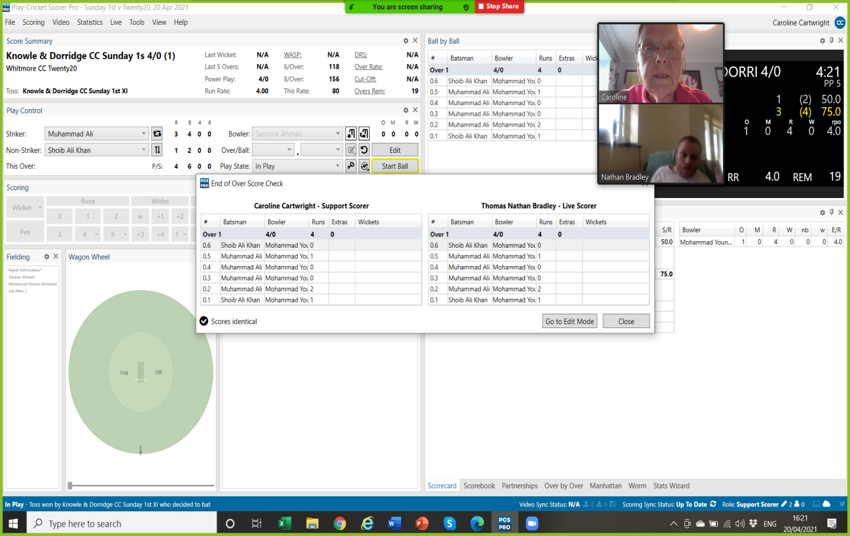

Slide 6
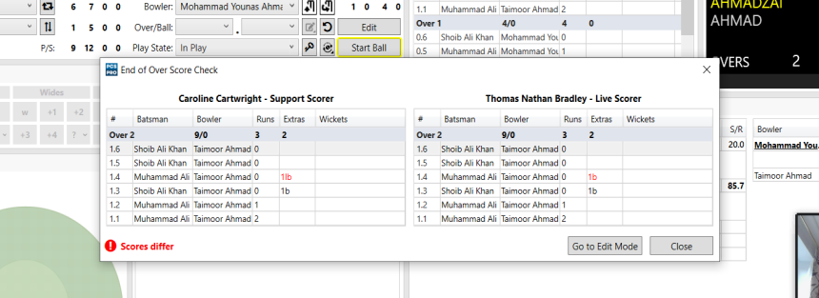
Collaborative Scoring – Play!
Any anomalies will appear in red text - “Scores Differ” will show in the bottom left corner of the dialog box
If the scores differ DO NOT ignore the dialog box. Use it to find the what the error is and who made it

Slide 7
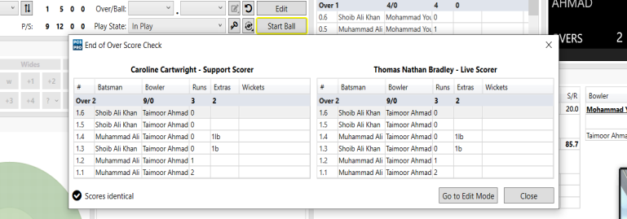
Collaborative Scoring – Play!
When you have remedied the error highlighted by the end of over score check, it will re-trigger the check as you exit Edit Mode to confirm that the amendment is correct
Scorers should check that scoring is in perfect agreement with each other. If dialog box says “Scores Identical” you can dismiss the box

Slide 8
Collaborative Scoring - Summary
Sue Drinkwater has done a podcast – link to be supplied shortly
Will only work if everything is correctly set up and steps taken in right sequence.
Both Scorers need to have the correct settings in their Tools menu.
The bottom right-hand blue task bar will show the current synchronisation status
Relies on both Scorers having a good Internet connection to PlayCricket throughout the match.
The Home Scorer must complete the set up before the Away Scorer starts.
It will automatically check that the scorers agree at the end of every over.
Scorers have to be able to communicate directly with each other to be able to resolve any errors immediately
Good Luck
PPTX V4. 28.iv.21 originally authored by Caroline Cartwright with minor edits by Colin Pearson

